Slide 1
How to Apply to Academia: How to get a faculty position from an industry job
Rob Candler

Slide 2
Preparation
My background
Is academia what I want?
In grad school
After grad school
Application

Slide 3
My Background
PhD in Electrical Engineering, Stanford University, 2005
3 years post-graduate “seasoning”
Corporate research (Bosch Research and Technology Center)
Consulting Assistant Professor
UCLA Assistant Professor

Slide 4
Is academia what I want?
The Good
Freedom
Hours
Research direction
Working with students can be fun
Teaching
The Bad
Long hours (we are self-managed and very demanding bosses)
Pressure of funding
Tenure process
Teaching

Slide 5
25 years of school and they didn’t teach me how to do my job…
Grad school training
Researcher

Slide 6
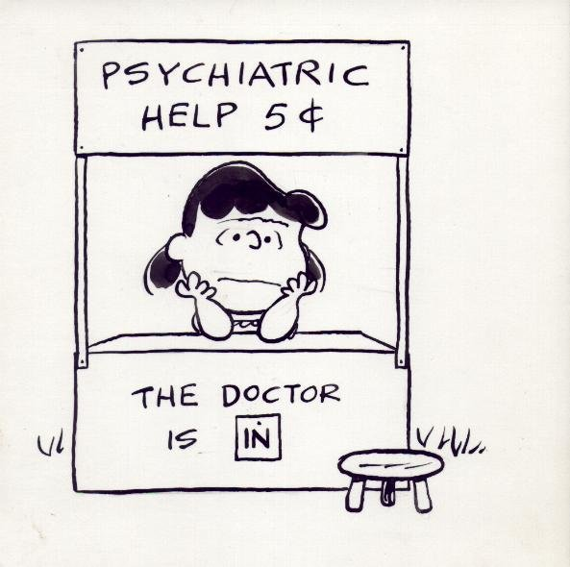
25 years of school and they didn’t teach me how to do my job…
Faculty job functions
Therapist
Salesman
Finance Manager
Researcher
Teacher

Slide 7
(Assuming you still want the job)What to do in grad school
PUBLISH
Journals – for archival record (varies by field)
Conferences – for contacts
Interdisciplinary work good – need to describe your contribution
Apply for fellowships – a little prestige
Do “faculty” things (to show you have the capability)
Teaching experience
Grant writing experience
Notes:
Departments want to know that you can do things required of a faculty, beyond executing research

Slide 8
What to do after grad school
Many schools want you to season a little bit (2-4 years)
Old news for sciences
Newer thing for engineering
WARNING: If you’re out for more than ~5-6 years, you’ll be compared to tenured faculty for hiring (your peer group)
Option 1: post-doc
Option 2: corporate research

Slide 9
Option 1: post-doc
Traditional route
Different university
Definitely different adviser (some notable exceptions, especially if you are on the verge of a breakthrough)
Stay visible (conferences, meetings)
Look for track record of success from faculty
Check for SPECIFIC cases
Faculty without a track record is ok, too, as they will feel pressure to make you their success story, which is good. Faculty who have had many postdocs that don’t make it is not a good sign

Slide 10
Option 2: Corporate research
Pros
Cons
A different experience/perspective
A good paying job
A good career start if the academic search doesn’t pan out
Difficulty in publication
Loss of continuity in research
People make false assumptions about your goals (e.g., “Why did you decide to quit industry and come back to academia”)

Slide 11
Option 2: Corporate research
Pure research lab is a thing of the past
Can work well and get you industry experience and connections, but you have pick the job very carefully. You can ask “Do you allow publication?” Better than that, however, is to ask what publications have come out of their group in the past 5 years.
Consulting/adjunct professorships are good
Attend conferences, get on the review committees, if possible

Slide 12
Getting the interview - the nuts and bolts of the process
Find schools via Academic Keys, individual school websites, etc
Applications due in December/January
Interviews typically in March/April

Slide 13
Getting the interview
Primary Challenge: There are MANY qualified candidates, so you need to distinguish yourself
Have an ADVOCATE!!!! (preferably senior member of the faculty familiar with your work)
This emphasizes the importance of conferences

Slide 14
At the interview
Job talk
45-60 minute talk (work from your thesis and subsequent research with some high-level motivation)
Level: Smart faculty that may not be experts in your exact area – include high level motivation
Be clear about your contributions, especially for a project that was larger than you
Future work: ~ 3 topics you want to work on in the future, showing some breadth/vision (i.e., not all continuation of your PhD)
Major concern is whether faculty candidate can start and sustain successful research program
Many, many 30 minute meetings with faculty members
Be enthusiastic!
Have a few summary slides to summarize your work
Read their papers – primarily to find areas of possible collaboration

Slide 15
Elevator pitch exercise
Pair up
1 minute for each person to describe their research to the other person
Now, tell the other person what you learned from their pitch. Specifically,
High level impact
State of the art
How your work is an improvement over previous work (without trashing your colleagues)
What long-term impact you think you could have
If they are not clear on all of these, you should work on your pitch

Slide 16
After you get the faculty position
Come see me for the next round of advice (a much longer presentation)

Slide 17
Thanks!

