Slide 1
Long-wave infrared nonlinear optics program at Stony Brook University
Ilan Ben-Zvi
ONR MURI Kick-off meeting
UCLA

Slide 2
Proposed projects in long-wave IR nonlinear optics at Stony Brook University
Self-guiding of 1-10 TW, picosecond CO₂ laser pulses over 100 m in air at the BNL ATF II in collaboration with the UCLA group and other MURI collaborators
Development of a 100 MW, high-repetition rate (5 Hz), 200 ps, 9 – 10 µm and 4 – 5 µm CO₂ laser system at the UCLA Neptune Laboratory (while ATF II is coming on line)
Apply 100 MW source for measurements of the of the nonlinear refractive index of atomic and molecular gases from 4 – 5 µm and 9 – 10 µm at UCLA

Slide 3
Self-guiding of 1-10 TW CO₂ laser pulses over 100 m in the air at BNL ATF II
Goals
Demonstrate guiding over 100 m in the air using 1-10 TW pulses
- P_{crit} ~0.5 TW
Diagnose LWIR radiation after nonlinear propagation
Spatial
Spectral
Temporal

Slide 4
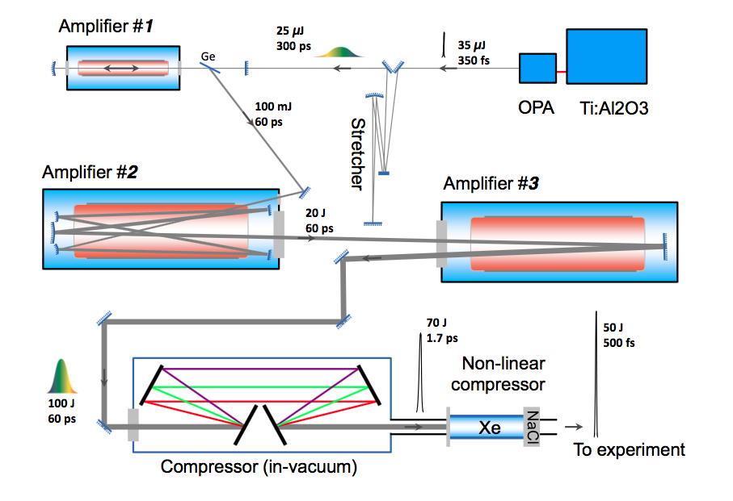
10 TW CO₂ laser system at the BNL ATF II
30 – 50 J, 3 – 5 ps
10 TW
(P_{crit} ~ 0.5 TW in air)

Slide 5
Self-guiding of 1-10 TW CO₂ laser pulses over 100 m in the air at BNL ATF II
Timeline for experiments
ATF II will be available for experiments in 2019 or even later
Research effort prior to this date will be dedicated to nonlinear refractive index measurements at UCLA
What is P_{crit} in the IR?

Slide 6
Development of a high-repetition rate (5 Hz), high-power, tunable IR source at UCLA Neptune Laboratory
Goals
Design a high-repetition rate (5 Hz), tunable CO₂ laser MOPA using existing hardware at UCLA, independent from UCLA’s current picosecond CO₂ laser system.
Source will be designed for nonlinear refractive index measurements in gases over a range of IR wavelengths (4 – 5 µm and 9 – 10 µm)
Produce 100 MW, 200 ps CO₂ laser pulses from 9 – 10 µm
Apply high-power 9 – 10 µm pulses to produce ~ 20 MW, 200 ps 4 – 5 µm radiation by efficient second harmonic generation

Slide 7
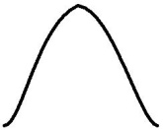
Development of a high-repetition rate (5 Hz), high-power, tunable IR source at UCLA Neptune Laboratory
CO₂ master oscillator
500 ns
9-10 µm pulse
1 µm Nd:YAG
100 MW, 200 ps
9-10 µm pulse
Optical parametric amplifier
TEA CO₂ laser final amplifier
Second harmonic crystal
Semiconductor slicing
~20 MW, 200 ps
4-5 µm pulse
Field broadened
200 ps
9-10 µm pulse

Slide 8
Measurements of the of the nonlinear refractive index of atomic and molecular gases in the infrared (at UCLA)
Goals
Nonlinear refractive index measurements of atomic and molecular gases using third-harmonic generation at 1 µm, 4 – 5 µm, and 9 – 10 µm
- What is the dispersion of n₂ in the infrared?
IR resonances of minor air constituents such as CO₂, H₂O, and NH₃ may affect the nonlinearity of air
Pump-probe experiments to measure the time dependence of the nonlinear response of molecular gases pumped by IR radiation in 9 – 10 µm and 4 – 5 µm range
Probed using 1 µm, picosecond interferometry
Probe sampled from laser system front end, deterministically synchronized with IR pump

Slide 9
Conclusions
Stony Brook University will lead effort on self-guiding at BNL ATF II
To demonstrate self-guiding of 1 – 10 TW CO₂ laser pulses over 100 m in the air and to diagnose spatial, spectral, and temporal properties of guided radiation.
ATF II will become available in 2019
Prior to ATF II experiments Stony Brook University will perform nonlinear refractive index measurements at UCLA
Develop an independent, high-repetition rate, tunable source of high-power IR radiation from 9 – 10 µm and 4 – 5 µm at UCLA.
Measure n₂ of atomic and molecular gases in the IR spectral range.

