Slide 1
Gain Tailoring in a CO₂ Amplifier by Resonant Absorption in Hot CO₂ Cell
Dana Tovey, Sergei Tochitsky, Eric Welch, Chan Joshi
Neptune Lab, Department of Electrical Engineering
University of California, Los Angeles

Slide 2
Why is this Important?
UCLA Neptune Lab: World’s most powerful (15 Terawatt) Carbon Dioxide laser
High peak power can only be generated with very short, picosecond (10⁻¹² second) pulses
When 10 micron laser beam is focused, it produces very strong electrical fields
Applications
Generation of Light Channels in Air (laser weapon)
Particle Acceleration (cancer treatment)
Laser Fusion (potential unlimited energy source)

Slide 3
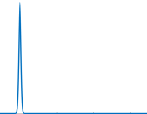
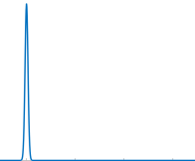
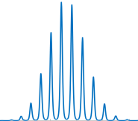
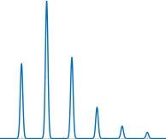
Amplification of Short Pulses
Input
Time Domain
Amplified Output
Frequency Domain
Time Domain
Smooth Gain Spectrum (Ideal)
3 ps
Time
Frequency
Time
Modulated Gain Spectrum (Realistic)
3 ps
18 ps
Time
Frequency
Time

Slide 4
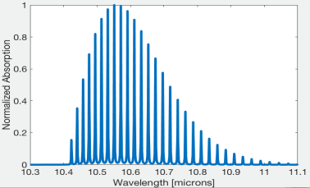
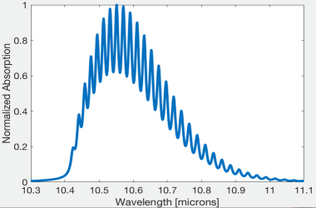
CO₂ Laser Gain Spectra
Pressure broadening
At higher pressure, spectral lines grow wider and overlap, smoothening the spectrum
Broader bandwidth means shorter pulses
Possible Solutions
Increase pressure (technologically difficult)
Use CO₂ isotopes to fill gaps in spectra (expensive)
CO₂ Absorption Spectrum at 1 atm
CO₂ Absorption Spectrum at 10 atm
~ 1 THz

Slide 5
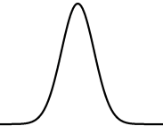
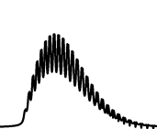
My Project
CO₂ Laser
CO₂ Hot Cell
E_{upper}
E_{lower}
gain
loss
loss
input
gain
gain − loss

Slide 6
Numerical Simulations
To simulate the effect of a hot cell, I used an open-source code “co2amp” designed to model amplification of short pulses in active CO₂ media [1]
Calculates amplitude and phase at each individual frequency
Conditions for laser were realistic, given by past experimental results
Gain coefficient: 2.2%/cm
Pressure: 8 atm (1:1:14 CO₂:N₂:He mix)
Cell Length: 50 cm
Simulated amplification of 3 ps pulse from 1 μJ to 1 mJ
Regenerative amplifier: Number of passes varied depending on amount of absorption by hot cell
[1] Mikhail N. Polyanskiy, "co2amp: A software program for modeling the dynamics of ultrashort pulses in optical systems with CO2 amplifiers," Appl. Opt. 54, 5136-5142 (2015)

Slide 7
Optimization
3 main variables to optimize for the hot cell
Gas Mix (CO₂ : N₂ : He)
Temperature
Total Pressure
Gas Mix: all results indicate pure CO₂ (1:0:0) works best
Optimizing Temperature
Fixed CO₂ Pressure = 2 atm
Optimizing Pressure
Fixed Temperature = 400 K

Slide 8
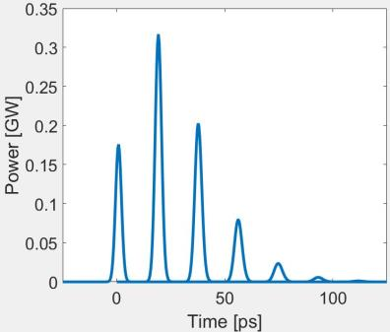
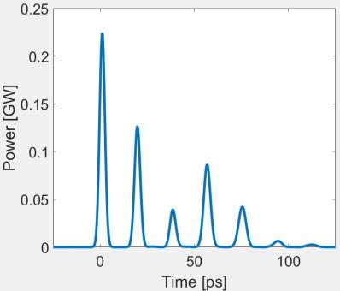
Simulation Results
Conditions taken from realistic experimental results
Gain coefficient: 2.2%/cm
Laser Pressure: 8 atm (1:1:14 CO₂:N₂:He mix)
Cell Length: 50 cm
Output without Hot CO₂ Cell
Output with Hot CO₂ Cell

Slide 9
Project Status
This academic year I plan to work 8-10 hours/week continuing this project
Design for hot cell is complete
Currently contacting companies about the building of customized parts
Goal: To build the hot cell and test this theory in lab by the conclusion of this academic year
Hot CO₂ Cell
L = 50 cm
Salt Window
Salt Window
Brewster’s Angle for NaCl = 56°

