Slide 1
LWIR Nonlinear Optics in gases: Theory and Simulations
UCLA MURI Kickoff 2017
Jerome V Moloney
College of Optical Sciences
Arizona Center for Mathematical Sciences
Research Team: M. Kolesik co-PI (OSC), S.W. Koch (Marburg), E.M Wright (OSC)
Senior Researcher/Postdocs: C. Dineen, K. Schuh, P. Rosenow, P. Panagiotopolous
Grad Students: A. Hofstrand (Appl. Math), J. Nehls (OSC)
Funding: MURI Award N00014-17-1-2705; AFOSR Support FA9550-16-1-0088
UCLA Lead: “Fundamental Studies of Nonlinear Optics and Laser-plasma Phenomena in Gases and Solids Using High-Power LWIR Lasers”

Slide 2
Talk Overview
Introduction
Background Theory
Developing light-matter coupling models [Task T2.2/T4.2]
Simulating 10µm Ultrashort Pulse Atmospheric Propagation [Task T3.4]
Conclusion

Slide 3
Research Overview
Our team has identified significant paradigm shifts modifying the physics of long range multi-TW pulse propagation at longer MWIR and LWIR wavelengths:
The new physics that emerges includes:
Optical carrier wave shocks – emitted dispersive waves facilitate low loss propagation
- P. Panagiotopoulos, P. Whalen, M. Kolesik, and J. V. Moloney, Nat Photon 9, 543-548 (2015).
Many-body Coulomb mediated dephasing of freed electrons significantly suppresses the nonlinear
induced Kerr self-focusing lens that confines the beam. – multi-km whole beam self-trapping.
- K. Schuh, M. Kolesik, E.M. Wright, S.W. Koch and J.V. Moloney, Phys. Rev. Lett., 118, 063901 (2017).
Important consequence: Higher power/energy low-loss transport over longer propagation paths within key atmospheric transmission windows.
Current LWIR USP sources power/energy limited:
10 µm CO₂ 45J 3 ps source at UCLA – launch beam issues, Brookhaven National Lab
10 µm CO₂ multi-Joule few ps source being developed jointly by NRL/AFRL – Victor Hasson consultant
Expected delivery to Dr. Andreas Schmitt-Sody AFRL

Slide 4
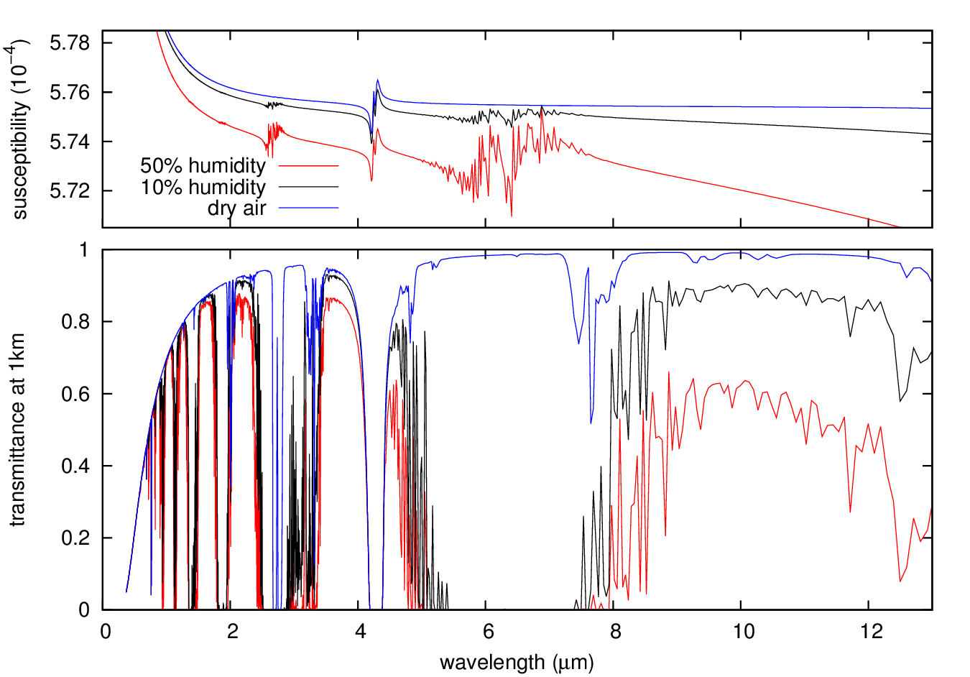
Atmospheric Transmission Windows (HITRAN)
MWIR LWIR
CO₂ Asymmetric stretch
8 – 12 µm Transmission

Slide 5
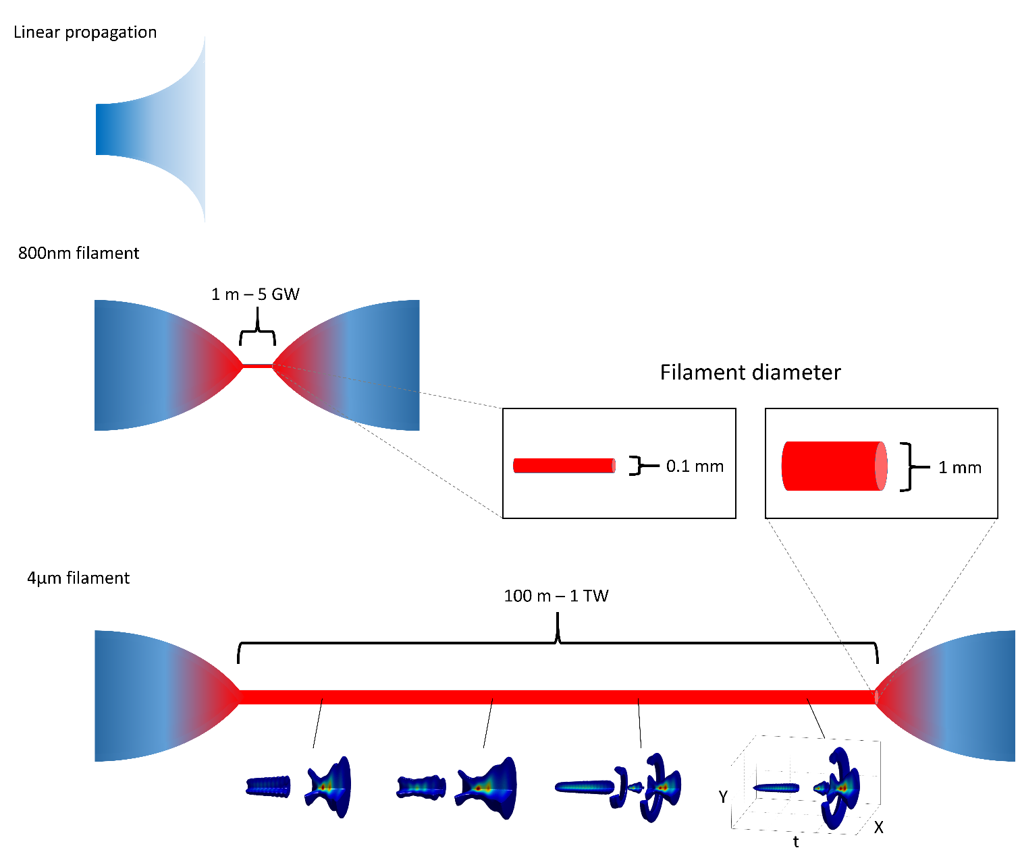
IR vs Mid-IR Atmospheric Filament Scaling
Ionization loss limits path length
Low loss propagation

Slide 6
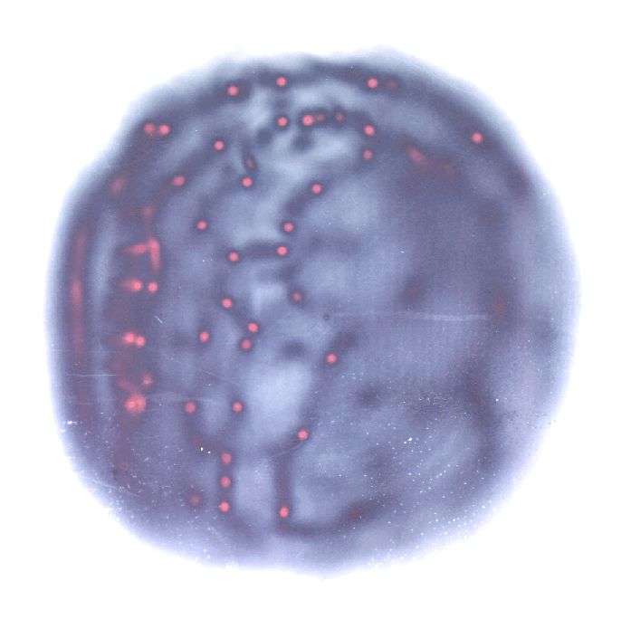
Chaotic Filamentation in 800nm TW Pulses
Relative disposition of filaments dictated by initial aberrations
across the beam
D.E. Roskey, M. Kolesik, J.V Moloney and E.M Wright
Appl. Phys. B 86 249 (2007)
NRL Laser Parameters
Pulse energy = 1.425 J
Pulse length = 400 fsec
Peak power = 3.56 TW
Propagation distance = 10 m
Individual filaments last for less than 1 m!
Whole beam diffraction limits range.
Intense self-focused
filaments
Veins are elevated ridges of
intensity on which modulational
instabilities grow
Broad background acts as an energy reservoir (photon bath) to sustain recurring filaments
M. Mlejnek, M. Kolesik, J.V. Moloney, E.M. Wright, PRL, 83(15) pp. 2938-2941 (1999).

Slide 7
Extended 3D NLSE Model - IR Filaments
Diffraction
GVD
Kerr Nonlinearity
Plasma Absorption/
refraction
Multi-photon absorption
Delayed Raman Response
- Plasma Drude Model
Avalanche generation
Multi-photon generation
Plasma recombination
M. Mlejnek, M. Kolesik, J.V. Moloney, and E.M. Wright, PRL,83(15) pp. 2938-2941 (1999).

Slide 8
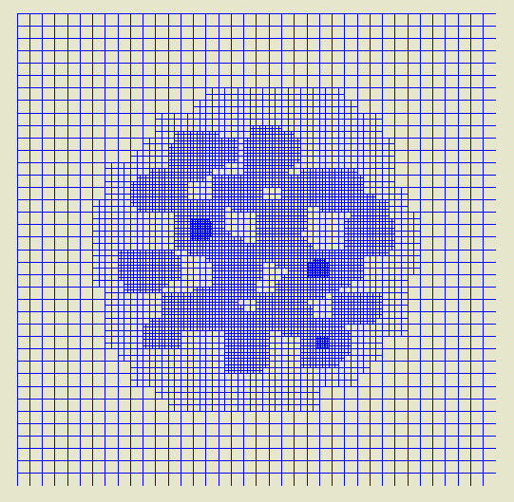
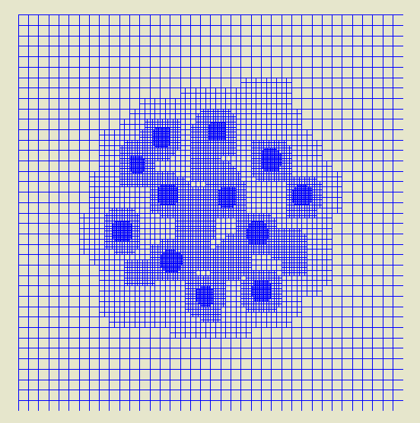
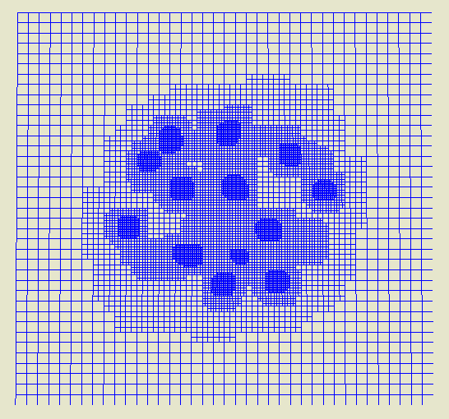
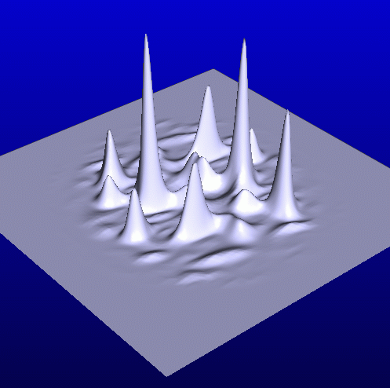
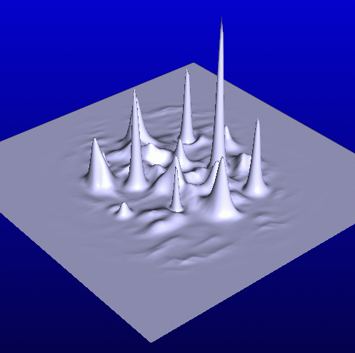
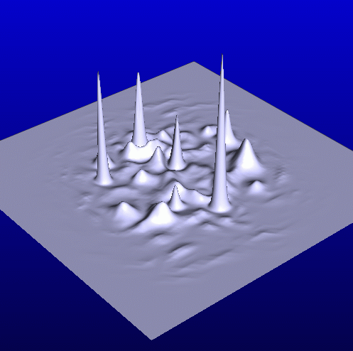
Adaptive Mesh GNLSE Parallel Solver
Dynamic regriding in space and time – Multiple light strings
M. Mlejnek, M. Kolesik, J.V. Moloney, E.M. Wright, PRL, 83(15) pp. 2938-2941 (1999).

Slide 9
Talk Overview
Introduction
Background Theory
Developing light-matter coupling models [Task T2.2/T4.2]
Simulating 10µm Ultrashort Pulse Atmospheric Propagation [Task T3.4]
Conclusion

Slide 10
Filament Modeling Hierarchy
Nonlinear Envelope Equation – Generalization of Nonlinear Schrödinger Equation
- Computational workhorse for near-IR filament propagation
Diffraction
Nonlinearity
Dispersion operator (normal or anomalous GVD)
J.V. Moloney and A.C. Newell, “Nonlinear Optics”, Perseus (2004)

Slide 11
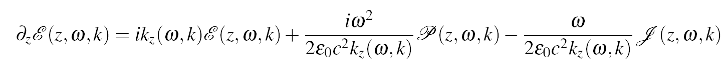
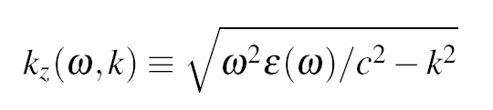
Scalar UPPE Model (Unidirectional)
Unidirectional Pulse Propagating Equation (z-UPPE)
Plasma-related current
Accurate chromatic dispersion
Nonlinear polarization evaluated from real field
Second Harmonic component = source of TH
Carrier based approach, no envelope approximations used

Slide 12
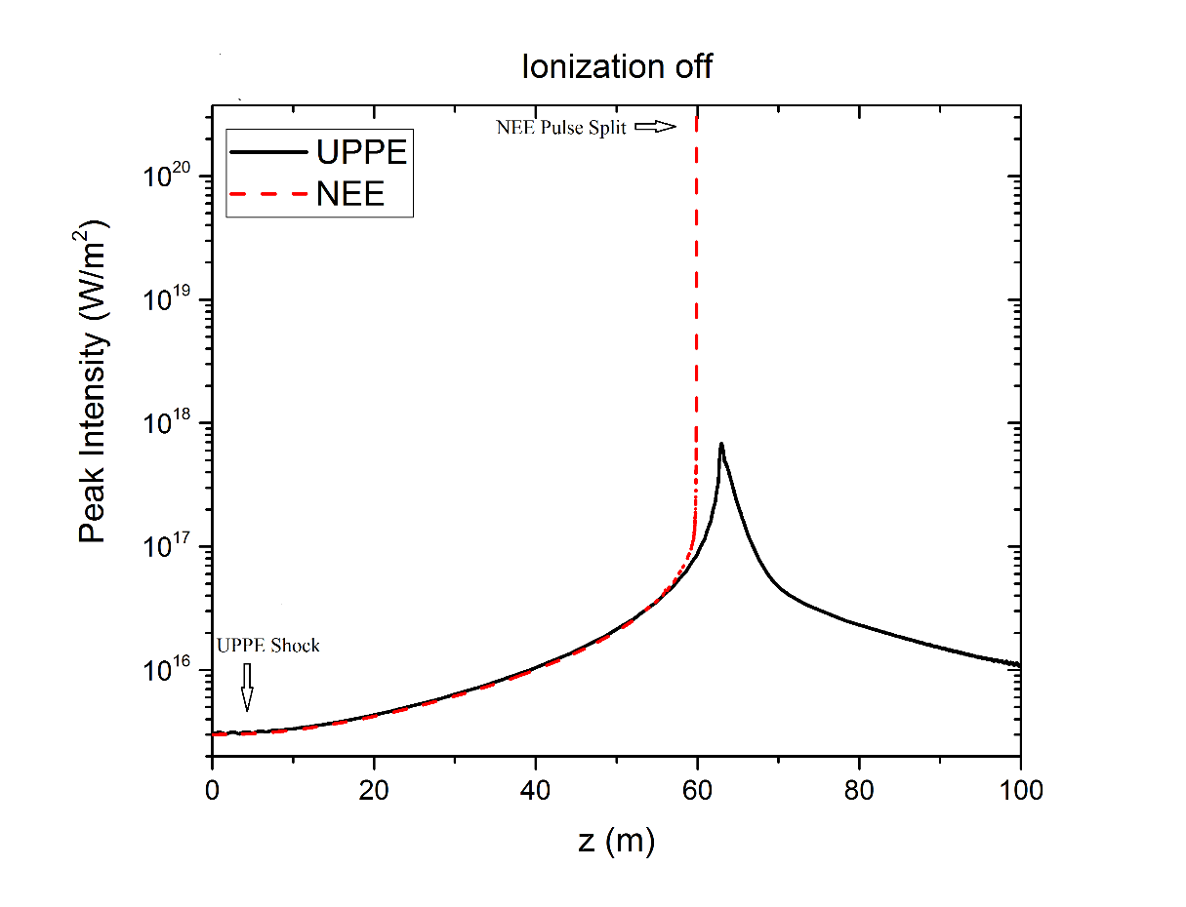
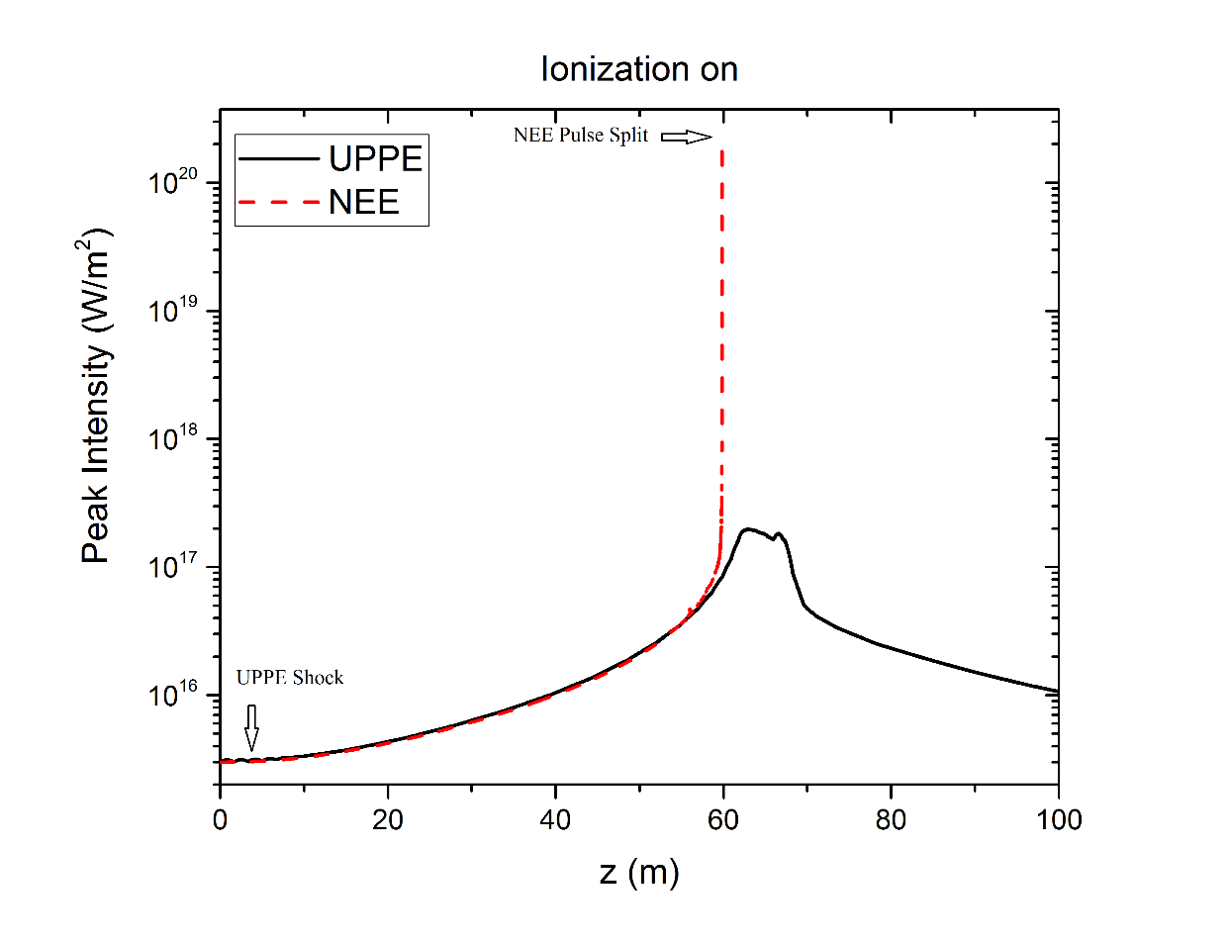
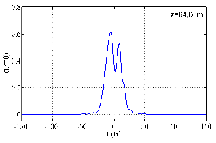
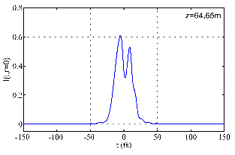
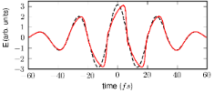
UPPE Carrier Shock Regularization – No HOKE or Ionization Regularization Necessary
Long wavelength limit of NLSE supports Luther et al. analysis (1994)
Weak dispersion of
ionized electrons
works in conjunction
Intrinsic GVD

Slide 13
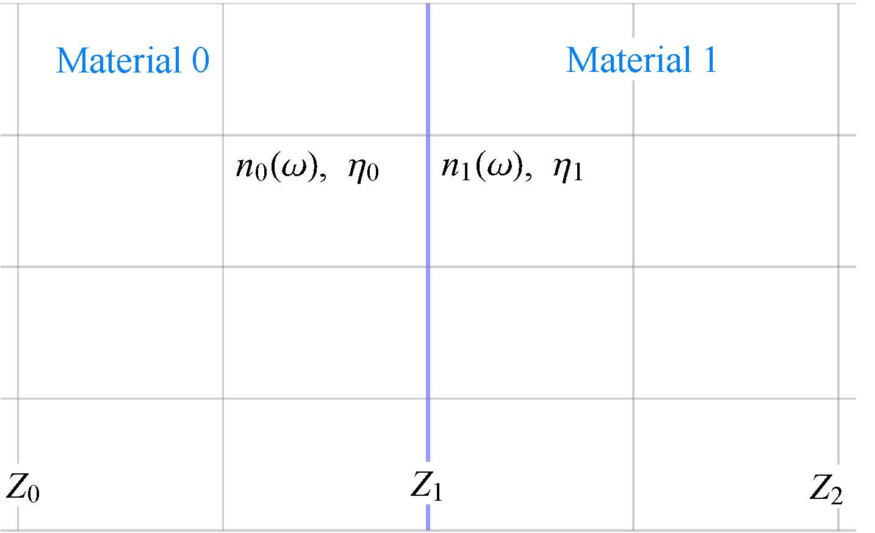
Beyond UPPE – Bidirectional Pulse Propagation
M. Kolesik, J.V. Moloney, “Nonlinear optical pulse propagation: From Maxwell's to unidirectional equations”, Phys. Rev E., 70, 036604 (2004).
Modeling the scattering of nonlinear ultra-short laser pulses from remote targets Andrew Hofstrand, UA

Slide 14
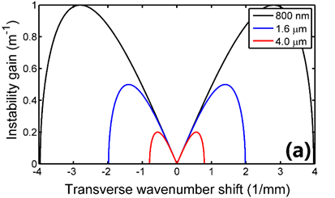
Modulational Instability – Filament waist scaling
Linearize NLSE around an infinite planewave:
Gain of perturbed transverse wavenumbers
Most unstable wavenumber growth rate
Observation:
Unstable transverse wavenumber domain shrinks with increasing wavelength.
Transverse size of perturbation grows with

Slide 15
Shock Singularity: infinite slope
Burger’s Equation:
Optical carrier
Shock regularization:
Korteweg – deVries (KdV):
Shallow water waves - Dispersive regularization

Slide 16
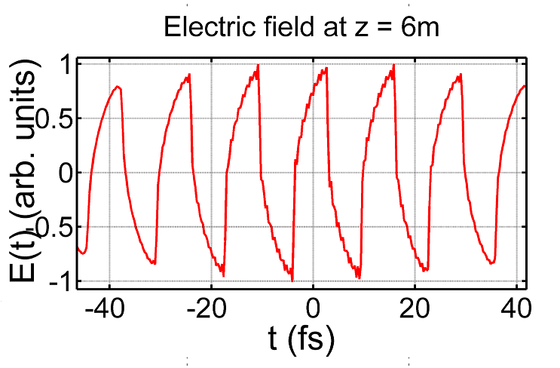
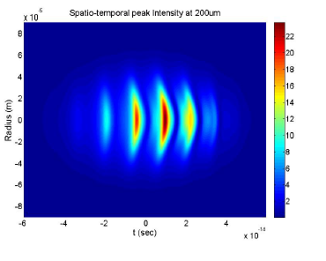
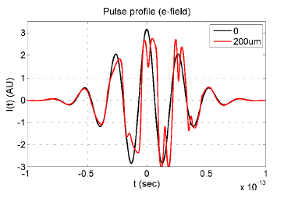
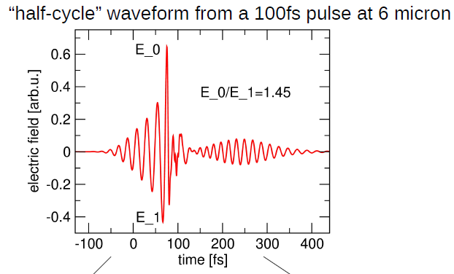
Modified Kadomtsev-Petviashvili (MKP1)
Canonical Full Field Propagator for long wavelength USPs
Asymptotic limit of UPPE for strongly nonlinear weakly dispersive waves
- K. Glasner et al, Int. J. Optics. http://dx.doi.org/10.1155/2012/868274 (2011)
Exhibits carrier shock + blowup - Originally derived for ion-acoustic waves
P. Whalen et al., Phys.Rev.A, 89, 023850 (2014); P. Panagiotopoulos et al. JOSAB, 32, 1718 (2015)
Balakin, A.A., A.G. Litvak, V.A. Mironov, S.A. Skobelev. JETP, 2007, 104 363-378
Carrier shock in Diamond at 8µm

Slide 17
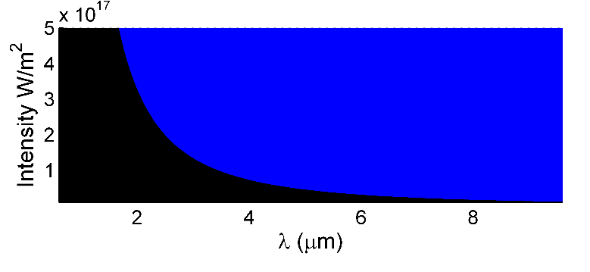
Shock Regularization is Universal for Long Wavelengths
UPPE
L_{NL} < L_{Disp}
Shock region
+ Collapse
Collapse
region
L_{NL} > L_{Disp}
NLSE, NEE etc
MKP

Slide 18
Talk Overview
Introduction
Background Theory
Developing light-matter coupling models [Task T2.2/T4.2]
Simulating 10µm Ultrashort Pulse Atmospheric Propagation [Task T3.4]
Conclusion

Slide 19
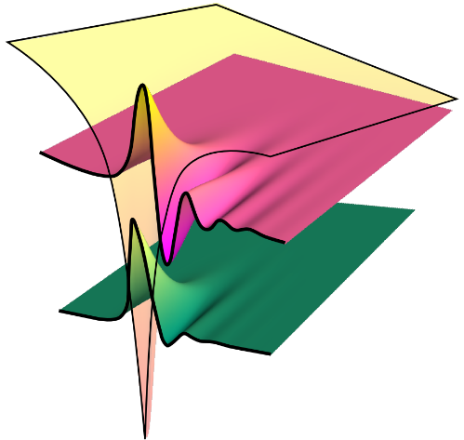
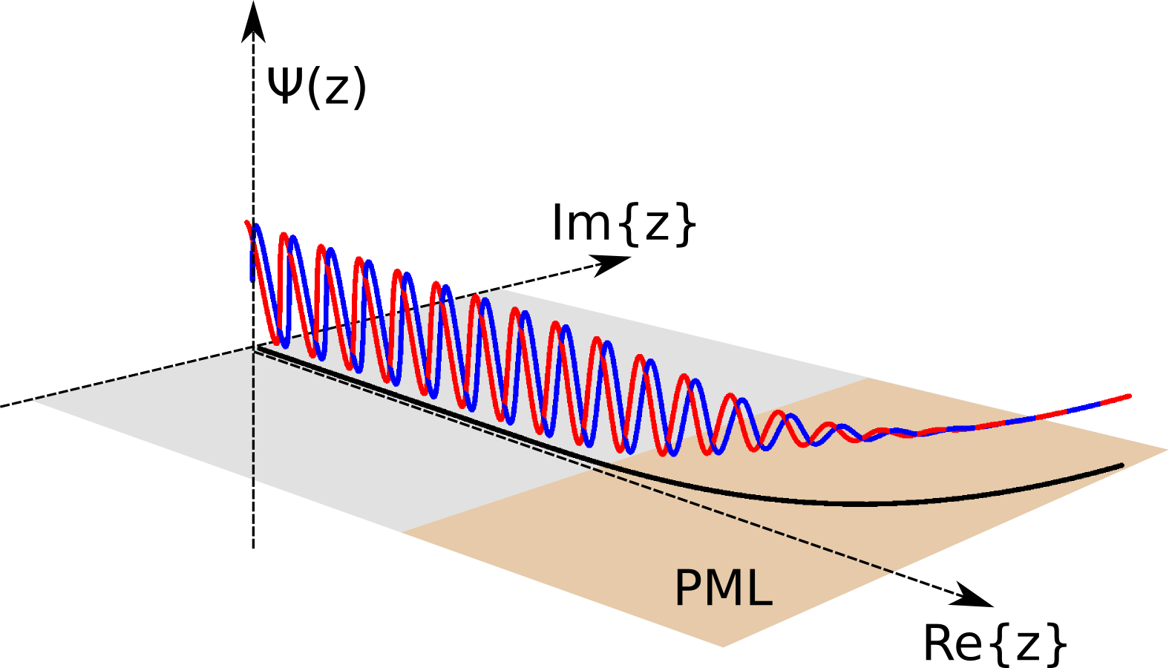
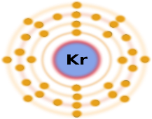
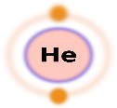
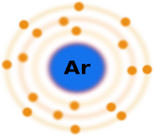
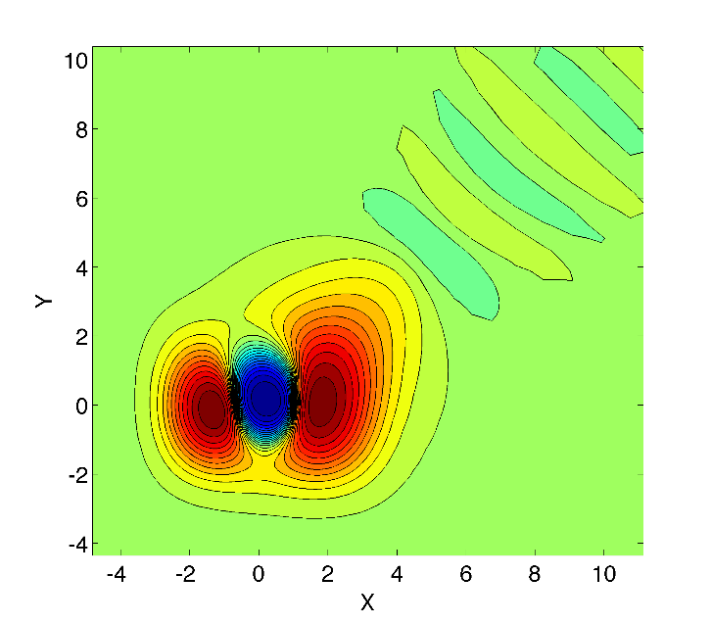
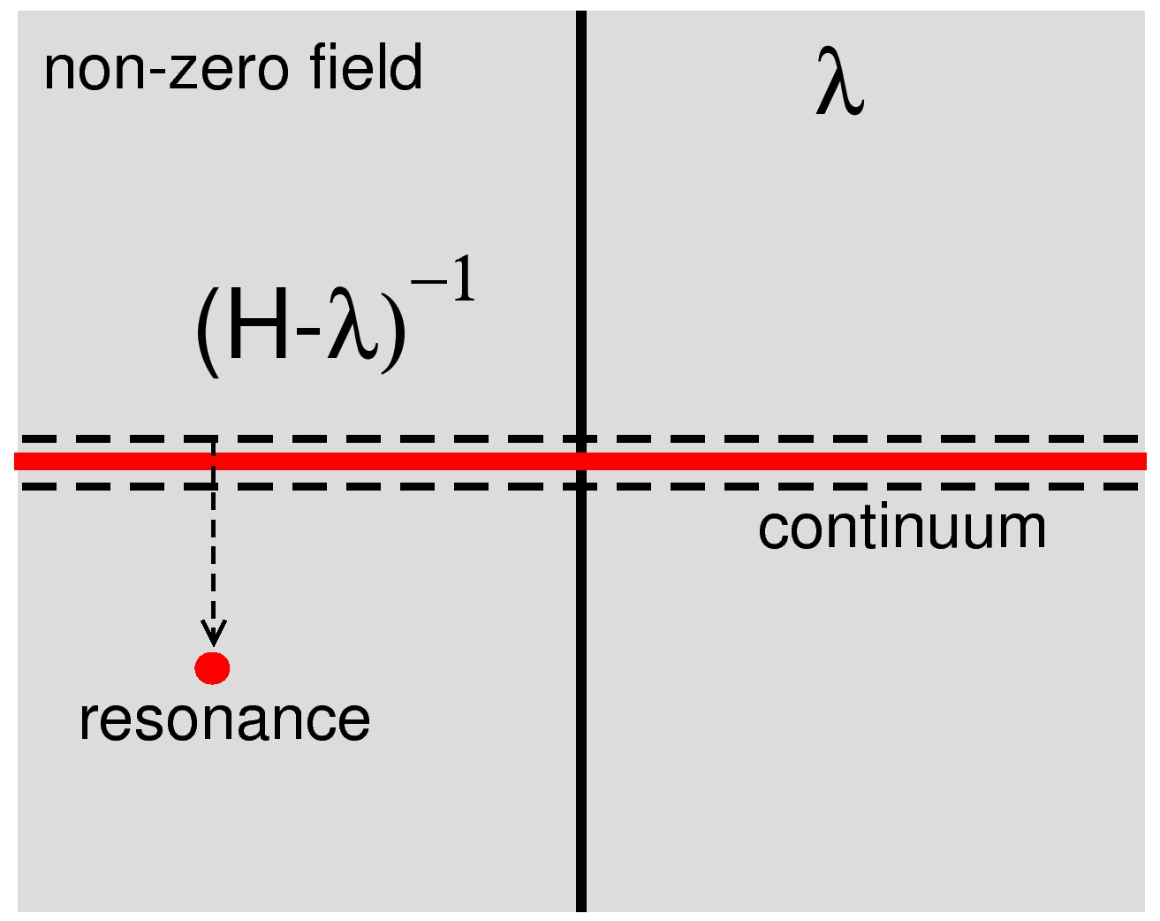
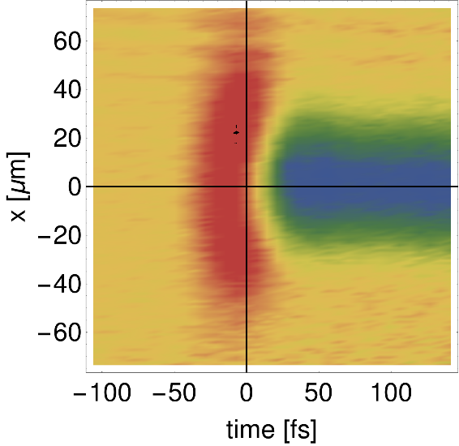
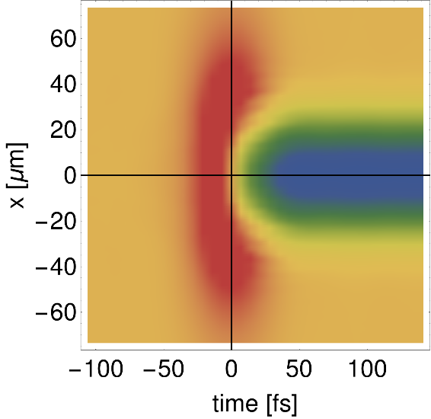
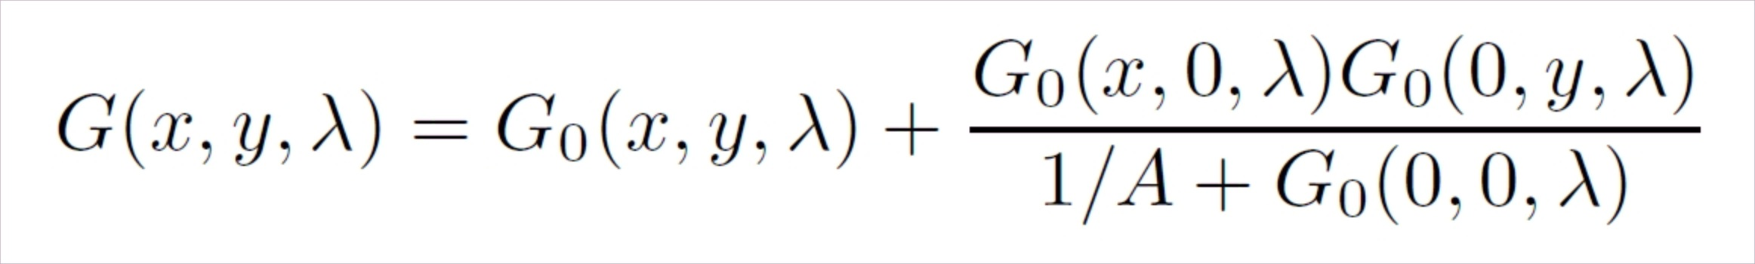
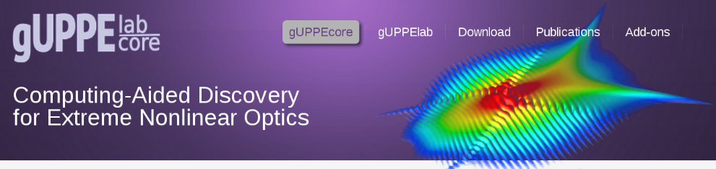
Metastable Electronic State Approach
Kolesik Group:
QM-models:
atoms and molecules
Non-Hermitian Quantum Mechanics
One-time system characterization
2P
Metastable State:
Response to optical field
2S
Guided by exact results
F
Experimental verification,
Time-space resolved comparison
Application: Large-scale simulations,
MESA=Module for gUPPE simulator

Slide 20
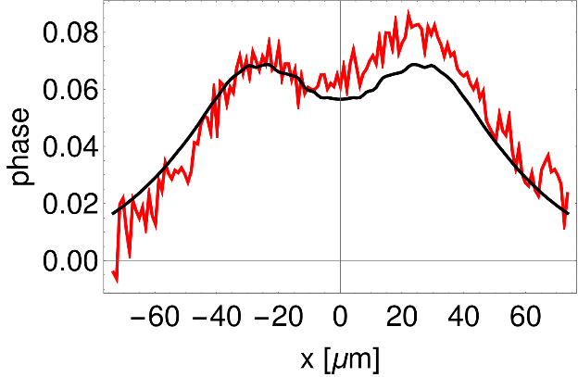
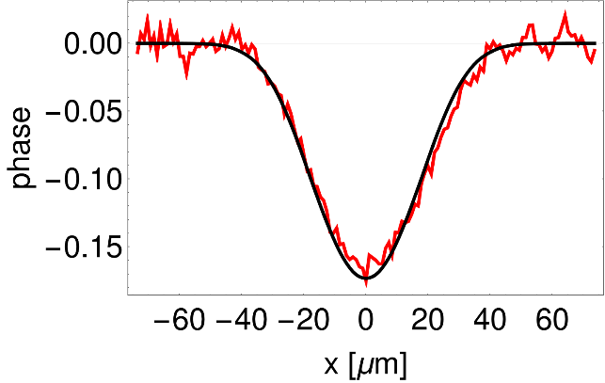

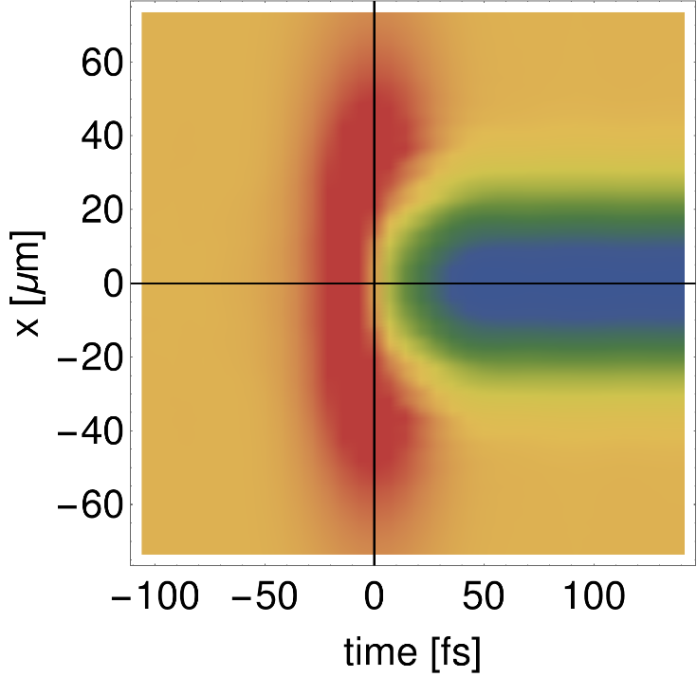
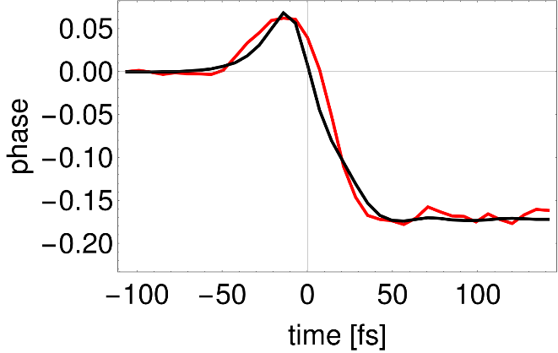
Experiment vs MESA comparison, high-intensity example
Kolesik Group:
Expt:Milchberg
Transverse profiles at different times
This case tests:
Nonlinear index
Ionization rate
Competition between
Kerr
Kerr vs Plasma
Plasma
Temporal profile
Exp.
Sim.

Slide 21
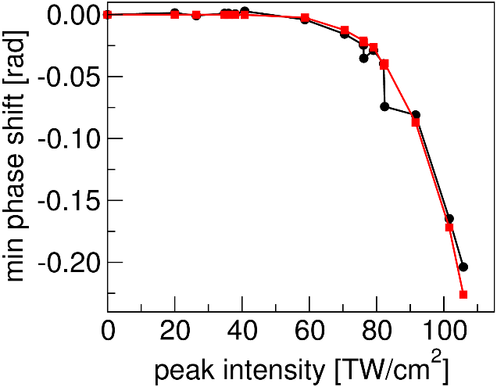
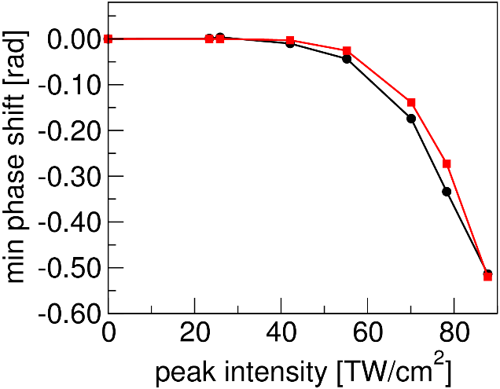
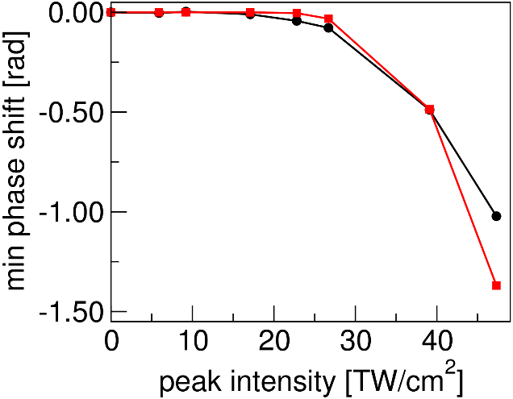
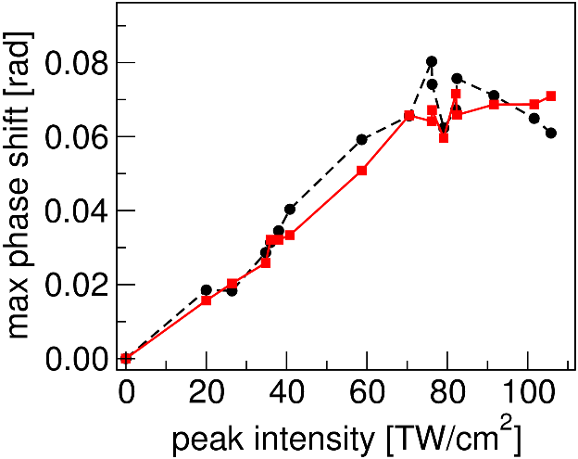
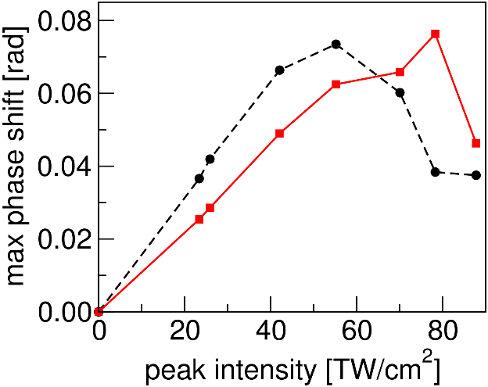
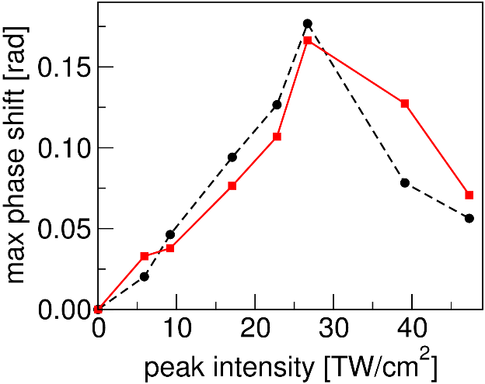
Experiment vs MESA comparison, “global picture”
Ar
Kr
Xe
Plasma
Kerr
Measured and simulated transient phase shifts versus pump intensity

Slide 22
Q: SAE versus ab initio
Atomic gases and Single-Active Electron:
Potentials available for inert gases
Relatively easy one-time characterization for MESA
Comparison with experiments justifies SAE
No real need to go beyond SAE
Molecules in MESA:
Only parameterized SAE potentials available
Results qualitatively OK
Quantitatively, N2 nonlinear index systematically too high
Ab initio can provide necessary data

Slide 23

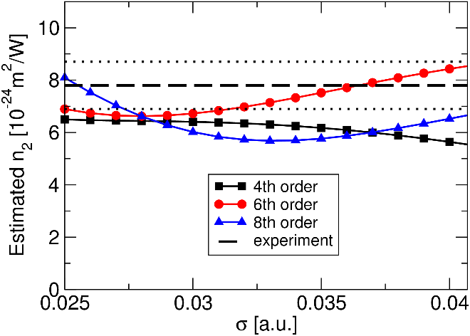
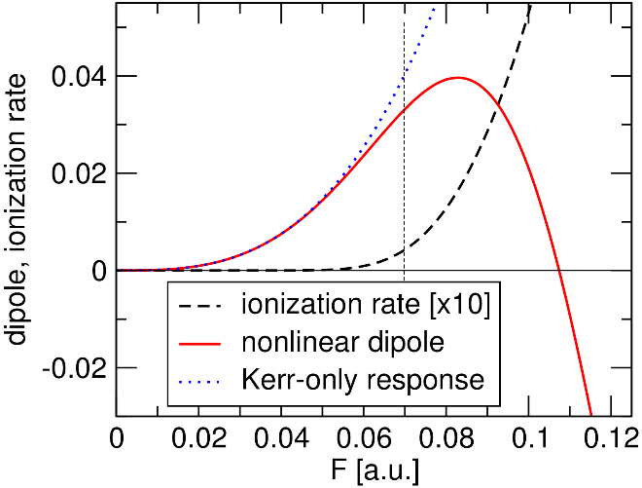
MESA model for molecular nitrogen
Kolesik Group:
Inputs:
haCC method (A. Scrinzi group)
Multi-electron
Captures ionizing states
Ab inito, no adjustable parameters
Outputs:
Linear polarizability (vs angle)
Nonlinear index
Higher-order nonlinearity
Ionization rate
Nonlinear index
from ab initio calculations
MESA model of N2
SAE approximation
F
Metastable wavefunction

Slide 24
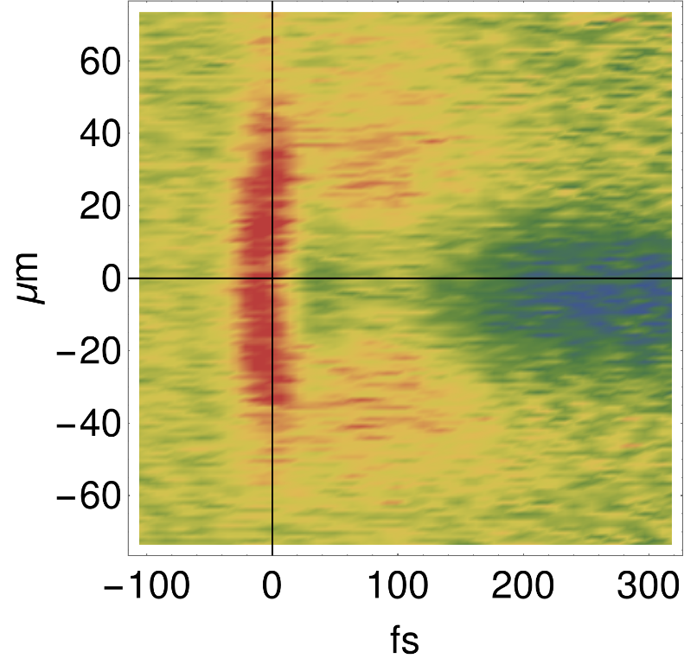
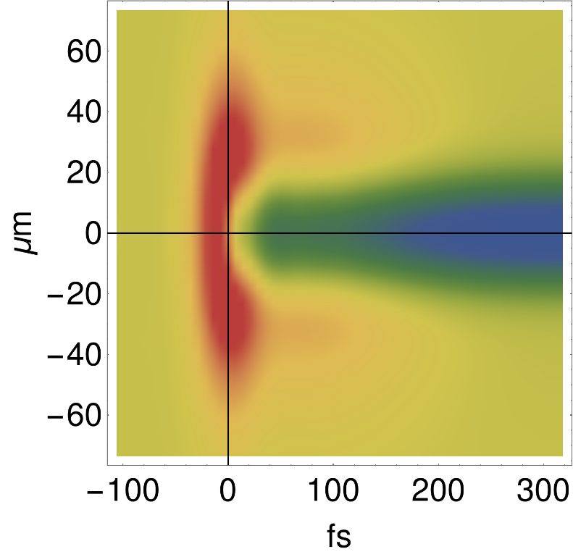
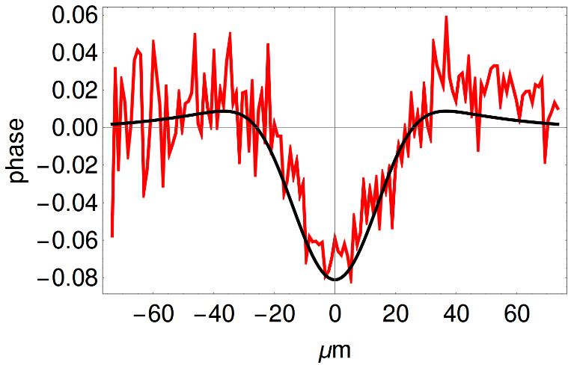
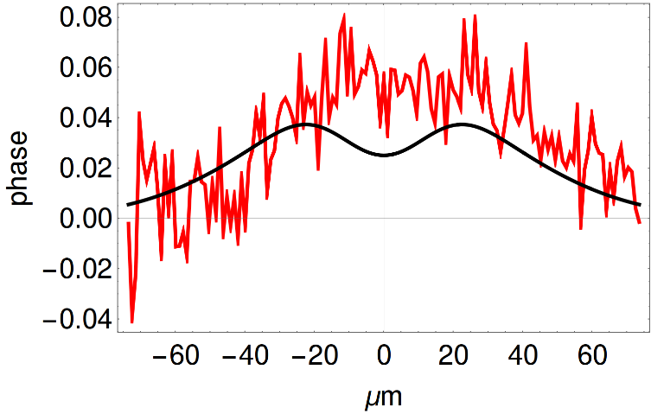
Molecular nitrogen model: Experimental verification
Exp.
Sim.
Kerr
Plasma
Raman
Transverse profile at different times

Slide 25
Molecular models in MESA: lessons from Nitrogen
Results so far:
Multi-electron, complex-valued Stark energy of the metastable ground state
Qualitative agreement with low-order harmonic generation
Encouraging comparison with SSSI experiments (in progress)
Next:
Other molecules, including CO₂, O₂
[1] J. K. Wahlstrand, Y.-H. Cheng, Y.-H. Chen, and H. M. Milchberg, Phys. Rev. Lett. 107, 103901 (2011).
[2] J. K. Wahlstrand, Y.-H. Cheng, and H. M. Milchberg, Phys. Rev. A 85, 043820 (2012).
[3] K. Y. Kim, I. Alexeev, and H. M. Milchberg, Applied Physics Letters 81, 4124 (2002).
[4] S. Zahedpour, J. K. Wahlstrand, and H. M. Milchberg, Opt. Lett. 40, 5794 (2015).
[5] J. K. Wahlstrand, S. Zahedpour, and H. M. Milchberg, J. Opt. Soc. Am. B 33, 1476 (2016).
Joint work (under Colorado MURI): A. Bahl, J.K. Wahlstrand, S. Zahedpour, H.M. Milchberg, and M. Kolesik
Nonlinear optical polarization response and plasma generation in noble gases:
Comparison of MESA models to experiments PRA, revision submitted

Slide 26




Nonlinear HITRAN Extension for Water – First steps
Moloney, Koch, Wrigth, Kolesik
K. Schuh et al., Physical Review A (accepted, Oct 2017) “Nonlinear rovibrational polarization response of water vapor to ultrashort long-wave infrared pulses”
142,000 transitions!
Cut-off criterion:
12,709
10 µm
Absorption spectrum – 50 fs

Slide 27
Talk Overview
Introduction
Background Theory
Developing light-matter coupling models [Task T2.2/T4.2]
Simulating 10µm Ultrashort Pulse Atmospheric Propagation [Task T3.4]
Conclusion

Slide 28

Long Wavelength Scaling of Critical Parameters
Critical Power:
Ionized Electron Polarization
ground state
Ionized Electron Density

Slide 29

Quantum Many-Body Equations for Coulomb Scattering
K. Schuh et al., PRE 88, 063102 (2013); PRE 89, 033103 (2104); PRE 93, 013208 (2016)
Assume ions are stationary
Requires solution of Quantum Boltzmann Equation

Slide 30

Self-Channeling of High Power LWIR Pulses in Atomic gases
K.Schuh, M. Kolesik, E.M. Wright, J.V Moloney and S.W Koch, PRL, 118 063901 February 10 (2017)
Single and multi-electron
ionization threshold
Many-body isolated atom

Slide 31




Many-Body Interactions of Weakly Ionized Electrons
K.Schuh, M. Kolesik, E.M. Wright, J.V Moloney and S.W Koch, PRL, 118 063901 February 10 (2017)
Effective Nonlinear
Index
Many Electron
Single Active and multi-
Electron (MESA)
M. Kolesik
SF Threshold
800nm
Effective Nonlinear
Index
Effective Nonlinear
Index
4 µm
10 µm

Slide 32

Long Range Multi-Joule Pulse Delivery
K.Schuh, M. Kolesik, E.M. Wright, J.V Moloney and S.W Koch, PRL, 118 063901 February 10 (2017)
Assumes an artificial Argon Atmosphere – remove complications of delayed nonlinearities.
Cumulative ionization (plasma) dispersion weakens effective Kerr lens
Beam characteristics at 10 µm
240 fs pulse – filament (red dashed), 3.7cm waist, 590 mJ
1.2 ps pulse - Self-trapped whole beam self-channeling (black dashed). 3.7 cm waist, 3 J
Weak self-focusing compression beyond 1.5 km
Rayleigh range

Slide 33



Multi-Kilometer Propagation at 10µm (no HITRAN)
Fix peak power above critical
Artificial Argon atmosphere (same electronic n₂ as air)
Increase energy (pulse duration)
Longer (higher energy) pulses tend to suppress strong focus but self-trap over longer ranges.
Rayleigh range
Strong pulse compression in time
Whole beam radial compression beyond 2km

Slide 34

Whole Beam Self-trapping

Slide 35


Non-Gaussian Vortex Beams
D. Gordon et al Proc. SPIE Vol 9835, (2016)

Slide 36




10 µm Air Propagation using HITRAN Database
Pulse parameters: 3cm waist, Peak intensity 8.2x10¹⁴ Wm², peak power = 1.14 TW – Optics Letts. 42, 3722 (2017)

Slide 37
Talk Overview
Introduction
Background Theory
Developing light-matter coupling models [Task T2.2/T4.2]
Simulating 10µm Ultrashort Pulse Atmospheric Propagation [Task T3.4]
Conclusion

Slide 38

Future Challenges and Research Goals
UPPE currently limited to radial symmetry for multi-km runs – almost ideal parallel scaling)
- 3D+1 simulations takes months on dedicated UV2000 system
(needed to study aberrations on exit beam)
- build in rigorously computed nonlinear responses as sources.
- DURIP proposal submitted – new generation of SGI hardware
Build a nonlinear HITRAN database for LWIR transmission windows
Extend UPPE to address scattering from remote targets
– hybrid UPPE-Maxwell solver (large angle scattering/transmission, excite evanescent waves at surfaces, etc
- implement bidirectional pulse propagator (BPPE) originally proposed in 2004.
Extend MESA quantum first principles scheme to calculate nonlinear response of
constituent air molecules – N₂, O₂ , H₂O.
- complement with DFT and ab initio quantum simulations.
Directly support AFRL/ONR USP programs through MURI interaction and direct
collaboration with AFRL team of Dr Andreas Schmidt-Sody.
N₂ wavefunction in strong field

Slide 39

Worst Case Scenario – Ground Level Turbulence
Simple estimate for linear propagation of a 1.5 cm beam
Longer wavelength favored in through turbulence
Scintillation appears further downstream
Problem: Rayleigh range decreases strongly with wavelength
Confined beam offsets diffraction making multi-km paths feasible.

Slide 40











Femtosecond Filamentation Science
Remote Delivery/Spectroscopy
Complexity
Coherent X-rays – 5000-th harmonic
Exotic Robust Pulses
White light
Curved Plasma Channels
Plasma channels
Plasma Enhanced
Radar
Plasma Waveguide
- HPRF/HPM

