Slide 1
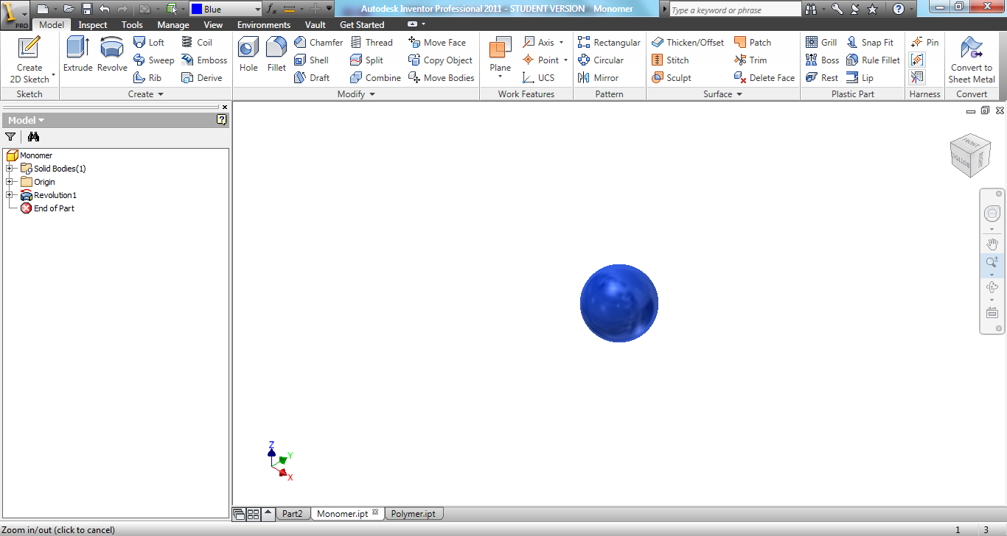
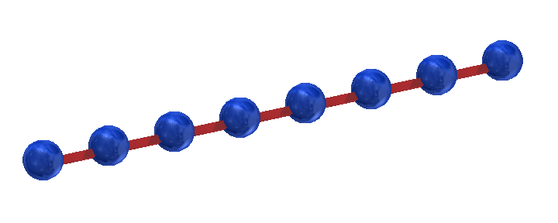
What is a polymer?
Polymers
Many units
Single units (monomers)
Get connected to make…
… a polymer chain!
Notes:
Let’s review what you’ve learned about polymers. What is a polymer? As the name suggests, “poly” means many while “mer” means a unit, therefore a polymer many units together. Each unit is called a monomer, and when you think a bunch of monomers together it forms a polymer chain.

Slide 2
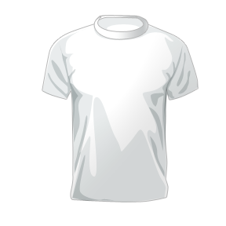
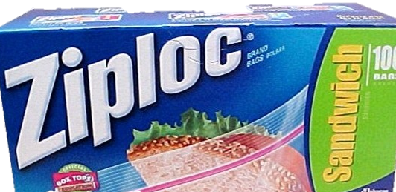
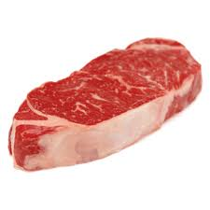
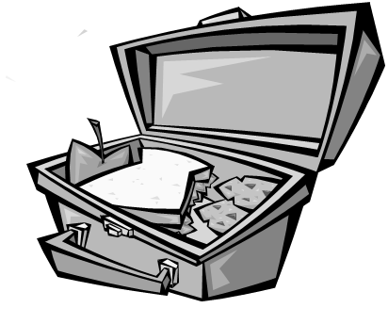
Do I know of any polymers?
www.ziploc.com
www.wiki.com
Notes:
There are a lot of things that are made out of polymers!
QUESTION: Can you think of anything in your lunchbox that might be a polymer?
If you use a plastic bag to hold your sandwich, your using a polymer!
QUESTION: What about your dresser?
If the shirt you have on today is made out of cotton (or polyester), you are wearing a polymer!

Slide 3
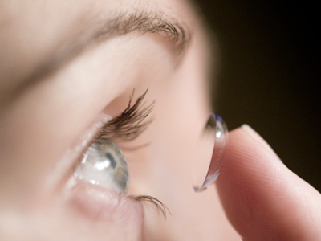
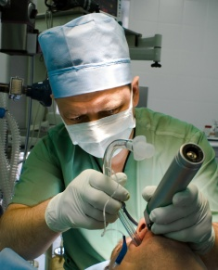
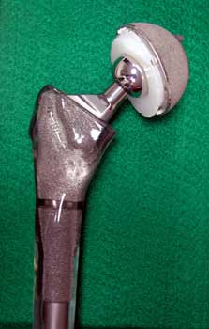
Polymers & the Body
www.avantgardeeyecare.com
http://www.anaesthesiacases.com
http://www.gentili.net
Things like polymers are considered…
… Biomaterials
Notes:
TRANSITION: Because there are so many polymers and they are all so different, they can be used to help people in various ways. One of the ways they are used is in the field of medicine.
As seen here, some polymers are used inside the body or come in close contact with the body.
EXAMPLES:
For a hip implant (Right picture), the polyethylene cup is smooth and allows for easy movement of the ball attached to the stem. The intubation tubing (center picture) is stiff enough to keep its shape but soft enough to bend into the throat. Lastly, contact lenses are made of polymers that are see-through (transparent) to correct our vision.
The polymers that are used in the body need to be “Biocompatible”. What do you think biocompatible means?
Biocompatible: The body won’t attack the material, thinking it’s bad or harmful. How many of you have had a splinter? What happens to the area around the splinter? (Answers: it gets red, swollen, hurts, etc.). Splinters are not ‘Biocompatible’ but what about contact lenses?

Slide 4
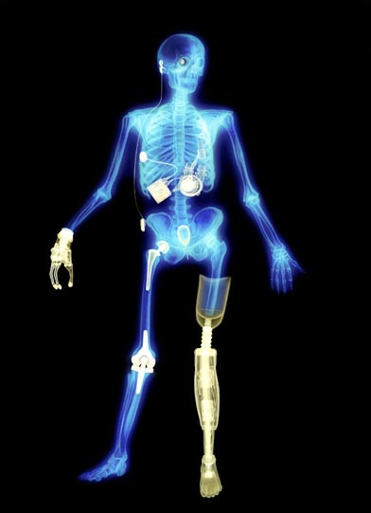
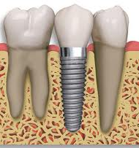
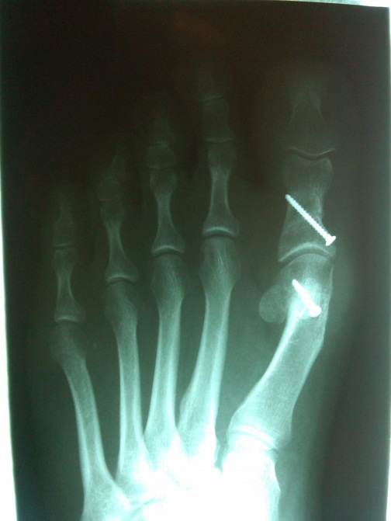
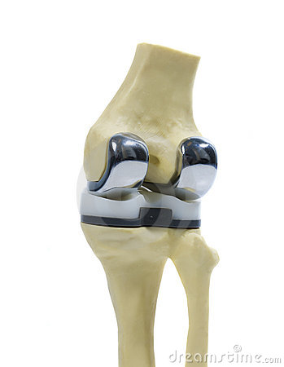
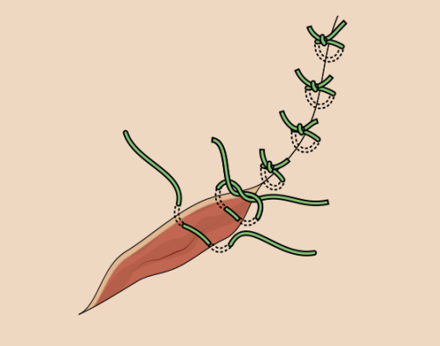
Biomaterials are all around
www.lawilshireperio.com
www.nebraskafootandankle.com
www.avantgardeeyecare.com
www.sciencemag.org
www.shortwhitecoats.com
www.dreamstime.com
Notes:
TRANSITION: There are other kinds of materials that are also considered ‘biocompatible’.
They can be made out of metal, like a hip implant, or ceramics in addition to polymers (which we’ve been talking about).
We call these materials: biomaterials
Because they interact with the body in a helpful way.

Slide 5
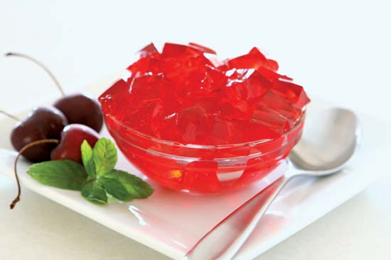
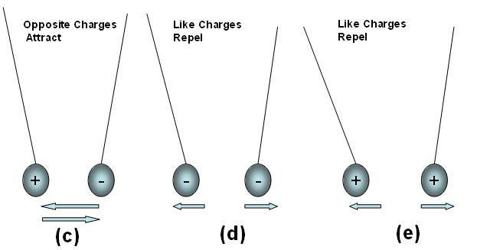

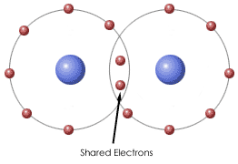
Some Polymers swell in H₂O
We call them
Hydrogels
water
http://kids.britannica.com
www.avantgardeeyecare.com
Polymer chains join together to make a solid material that is filled with H₂O. They are joined by…
http://kids.britannica.com
www.warrenfencecompany.com
www.wiki.com
Notes:
Take a polymer, crosslink it, add water to make a hydrogel! “Hydro” hints that there’s a lot of water involved. Jello is a great example of a hydrogel, it keep its shape but it’s a network swollen with water.
A biomaterial that is a hydrogel is contact lenses. Contact lenses are hydrogels to keep your eye from drying out, your eye is made of a lot of water.

Slide 6

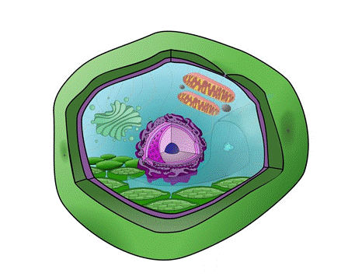
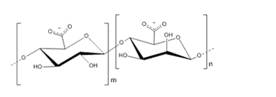
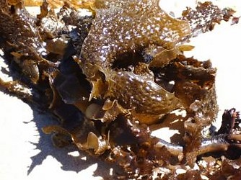
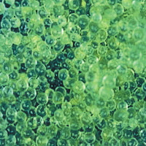
Is alginate found in nature?
www.wiki.com
Plant Cell
Ca⁺²
www.eaaroncohen.blogspot.com
www.bio-world.com
Brown Algae
www.tolweb.com
Notes:
Overall positive/negative idea, where it comes from
Alginate is found in nature. One source is from the cell wall of a plant cell. What kind of plant? From brown algae like you might have seen at the beach! In the lab, you’ll be using a heartburn tablet because alginate is a main ingredient in the tablet. When you take a heartburn tablet, the alginate forms a gel or foam on top of the acid in your stomach to help sooth the heartburn.

Slide 7
Need…
  a polymer
  way to join polymer chains
  water
How to:
  Get alginate (polymer) from heartburn tablets. Alginate has a -1 charge.
  Use calcium (+2 charge) to join the alginate chains
  Combine the two ingredients in water to make a your own hydrogels
Could we make a hydrogel ourselves?
Notes:
Could we make a hydrogel ourselves? What are the materials we would need? A polymer, a way to join polymer chains to create a solid network, and water to swell the network. We will be using a polymer called alginate from heartburn tablets. To crosslink our polymers, we will use calcium.

Slide 8
Work in partners to make alginate hydrogels
(start hands-on lab)
Notes:
Now let’s make our own hydrogels! Look at the student handout and follow carefully.

Slide 9
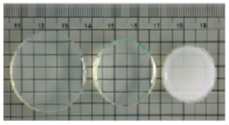


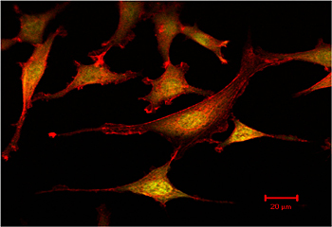
Cutting edge hydrogels
Control the release of medicine!
Heat sensitive hydrogels
www.intechopen.com
Increasing Temperature
Grow cells for making new tissue!
Light degradable hydrogels
www.udel.edu
Notes:
The hydrogels you just made are very similar to the ones used in research at UCLA. There are hydrogels which respond to heat by shrinking. By shrinking it can push out and deliver drugs.
Other hydrogels can respond to light and degrade, allowing for cells to spread and grow. Hydrogels are used in many different ways, they are an exciting biomaterial.

Slide 10
Brainstorm!
Can you think of where in the body you can use hydrogels?
How about…
      Bones?
      Eyeball?
      Skin?
Notes:
Wrap up summary
bone Hint: How hard are bones? → stiffness (hard or soft)
eyeball Hint: Does it need to be transparent? → some are not see through
skin Hint: Is it soft and has a lot of water? → squishy, yes, including internal organs
We hope you had a great time learning about polymers and hydrogels.

